Slide 1
Predicting Loan Defaults
Sanjog Sharma

Slide 2
Me After First Submission

Slide 3
Agenda
Provide an Overview problem
Discuss Preprocessing steps
Explore Feature Extraction
Explain Model and Ensembling

Slide 4
Kaggle: Give Me Some Credit
Kaggle competition with train and test sets
Predict delinquency
Lot of messy data

Slide 5
Messy Data
Missing Income and Number of Dependents
Lots of nonsensical data
Number of days due past 90: 90
Credit Utilization: 5,000,000 %
Max Debt Ratio: 32966400%.

Slide 6
Provided Features
Person experienced 90 days past due delinquency or worse
Total balance on credit cards and personal lines of credit except real estate and no installment debt like car loans divided by the sum of credit limits
Age of borrower in years
Number of times borrower has been 30-59 days past due but no worse in the last 2 years.
Monthly debt payments, alimony,living costs divided by monthy gross income
Monthly income
Number of Open loans (installment like car loan or mortgage) and Lines of credit (e.g. credit cards)
Number of times borrower has been 90 days or more past due.
Number of mortgage and real estate loans including home equity lines of credit
Number of times borrower has been 60-89 days past due but no worse in the last 2 years.
Number of dependents in family excluding themselves (spouse, children etc.)

Slide 7
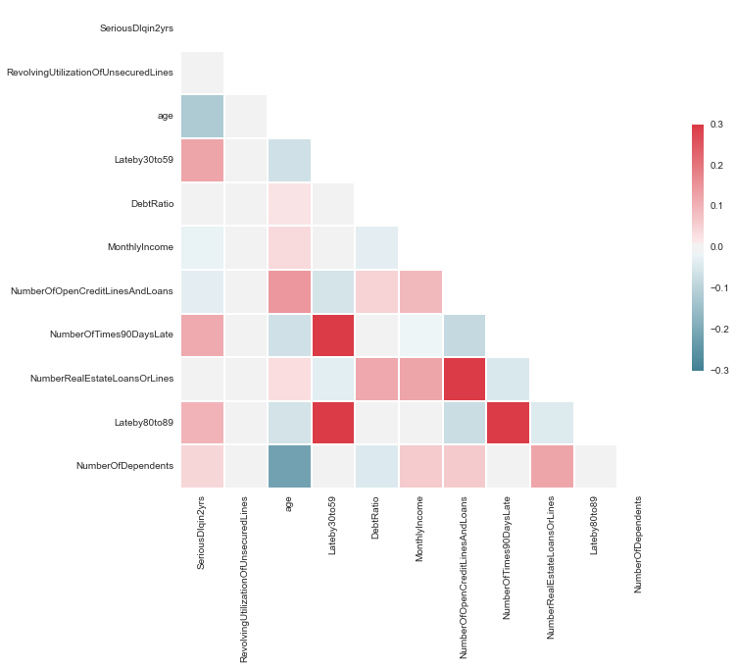
Correlation Heatmap

Slide 8
Preprocessing
Income:
Random Forest: RMSE of 1000
KNN Regressor: RMSE 14,000(unscaled)
Dependents:
Scikitlearn’s impute

Slide 9
Fixing other features:
Credit Utilization:
Separated those that didn’t make sense (over 1000%)
Used random forest to impute nonsensical: RMSE .68
Total late days:
Added late days
Used same approach as Credit Utilization

Slide 10
Features that could be potentially fixed
High income values:
Presses for time
Debt Ratio:
High and unreliable income

Slide 11
Feature engineering
Expenses
Savings
Credit Limit
‘free credit’
Log of everything
K clusters

Slide 12
Heatmap after FE

Slide 13
Modeling
Model | Accuracy%
GradientBoostingClassifier | 93.8%
Logistical Regression | 93.5%
RandomForestClassifier | 93.6%
ADABoost | 93.7%
Stochastic Gradient Dissent | 93.55

Slide 14

SVM

